Slide 1
Stroke
Case
27

Slide 2
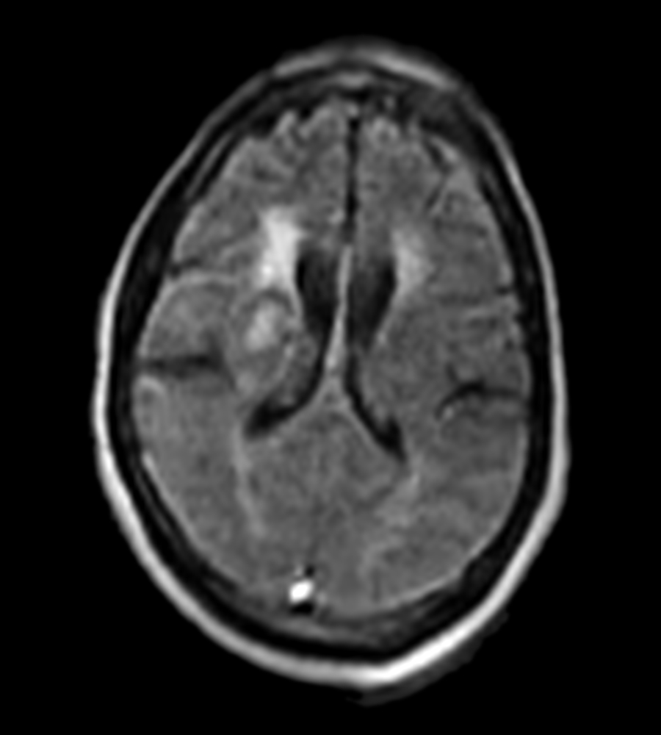
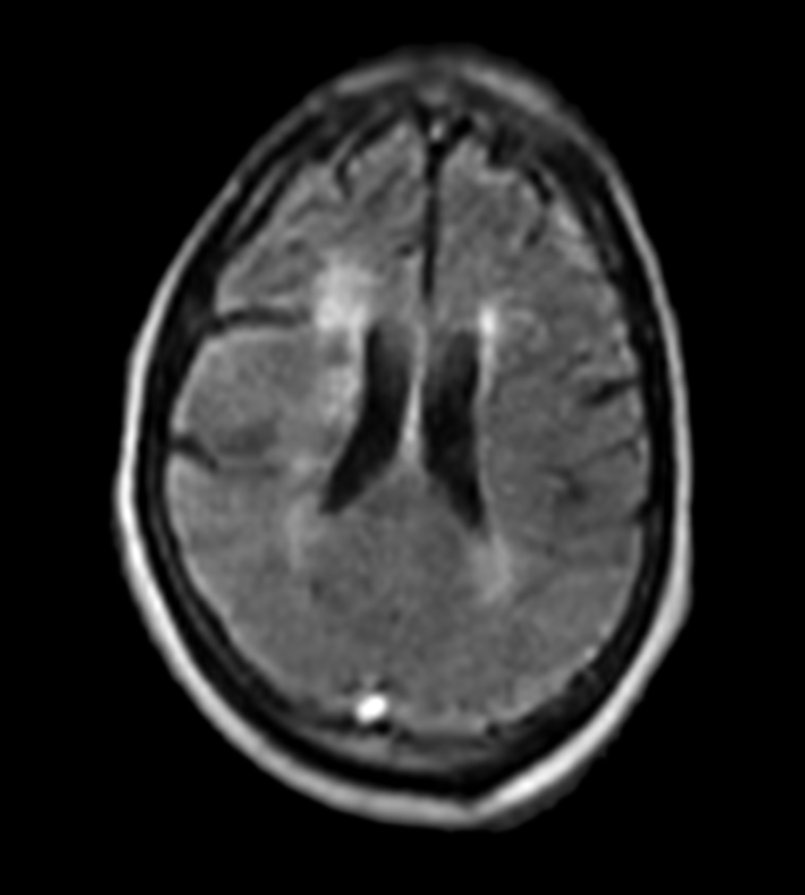
Stroke
A 56-year-old male presented in the ICU with left-sided facial droop and right-hand numbness lasting five days. Initial CT imaging revealed bilateral basal ganglia infarcts. Physicians performed bedside imaging with the Swoop® system and confirmed a new acute infarct in the right basal ganglia, while the left infarct appeared chronic.
FLAIR
FLAIR
Review images in Hyperfine, Inc. Image Viewer.
Case 027 - Stroke - 8.8 - LBL-003132 v0
Notes:
A 56-year-old male presented in the ICU with a five-day history of left-sided facial droop and numbness in his right hand. Concerned about possible cerebral events, Physicians conducted initial CT imaging, which showed bilateral infarcts in the basal ganglia. To further investigate and confirm the nature of these infarcts, they performed bedside MR imaging. Swoop® system images were used to identify a recent acute infarct in the right basal ganglia, while findings suggested the left infarct was chronic.

Slide 3
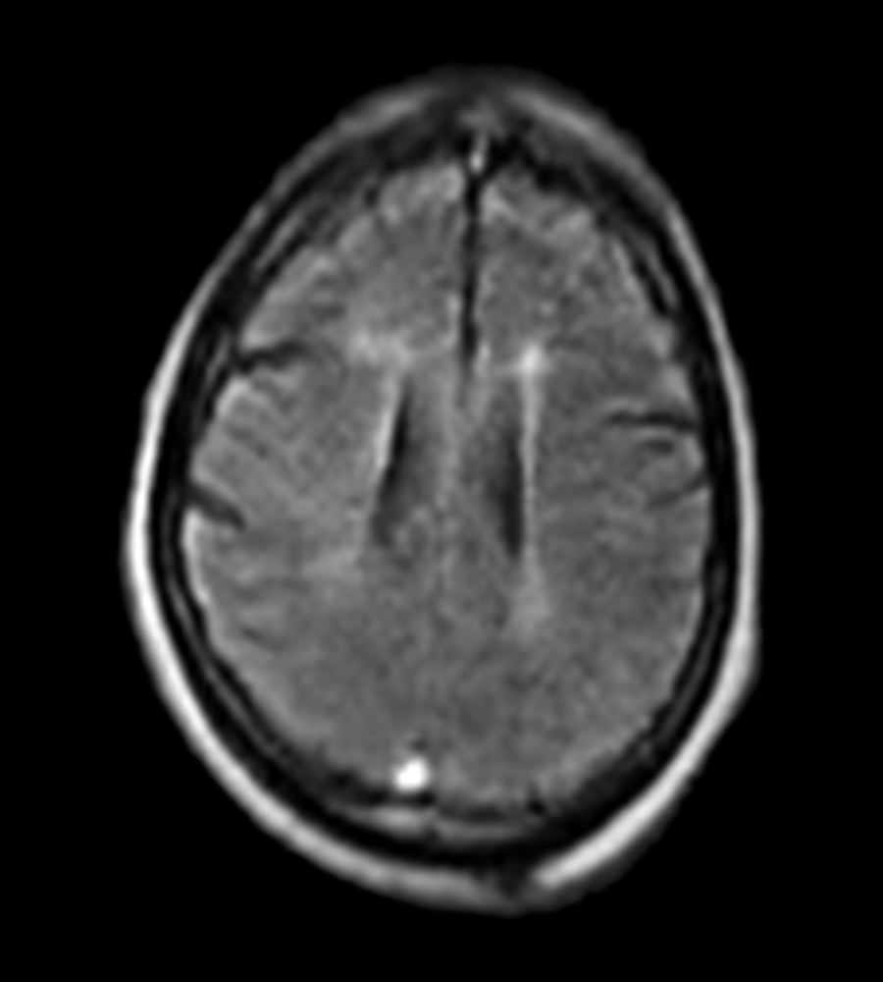
Stroke
A 56-year-old male presented in the ICU with left-sided facial droop and right-hand numbness lasting five days. Initial CT imaging revealed bilateral basal ganglia infarcts. Physicians performed bedside imaging with the Swoop® system and confirmed a new acute infarct in the right basal ganglia, while the left infarct appeared chronic.
FLAIR
Review images in Hyperfine, Inc. Image Viewer.
Case 027 - Stroke - 8.8 - LBL-003132 v0
Notes:
A 56-year-old male presented in the ICU with a five-day history of left-sided facial droop and numbness in his right hand. Concerned about possible cerebral events, Physicians conducted initial CT imaging, which showed bilateral infarcts in the basal ganglia. To further investigate and confirm the nature of these infarcts, they performed bedside MR imaging. Swoop® system images were used to identify a recent acute infarct in the right basal ganglia, while findings suggested the left infarct was chronic.

Slide 4
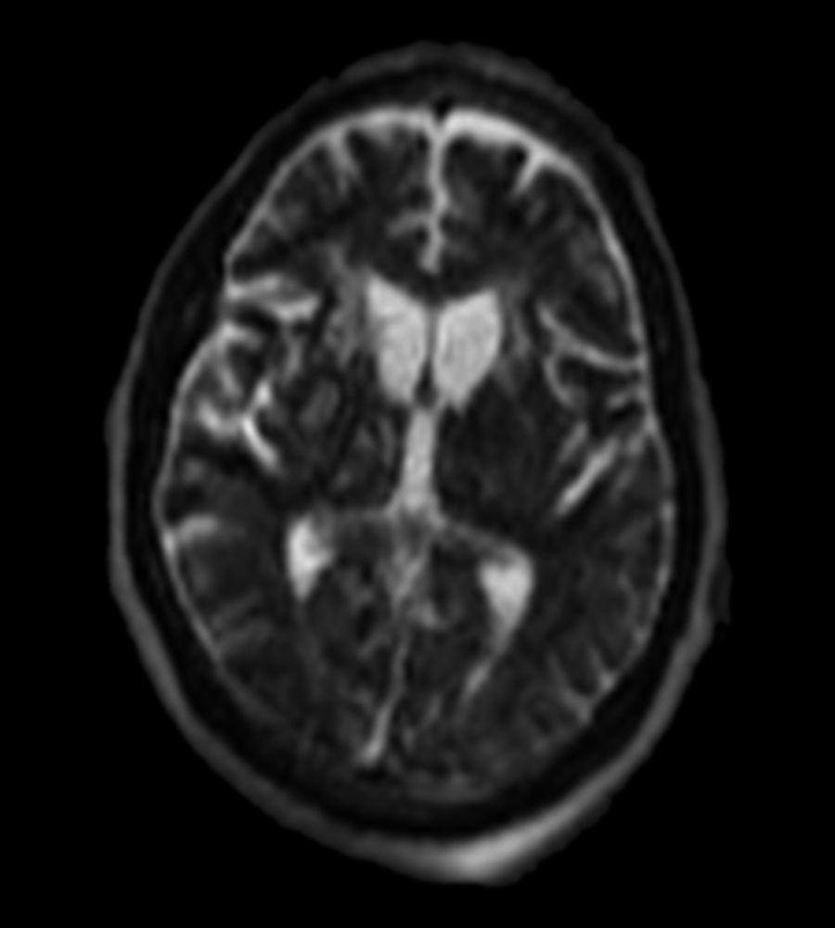
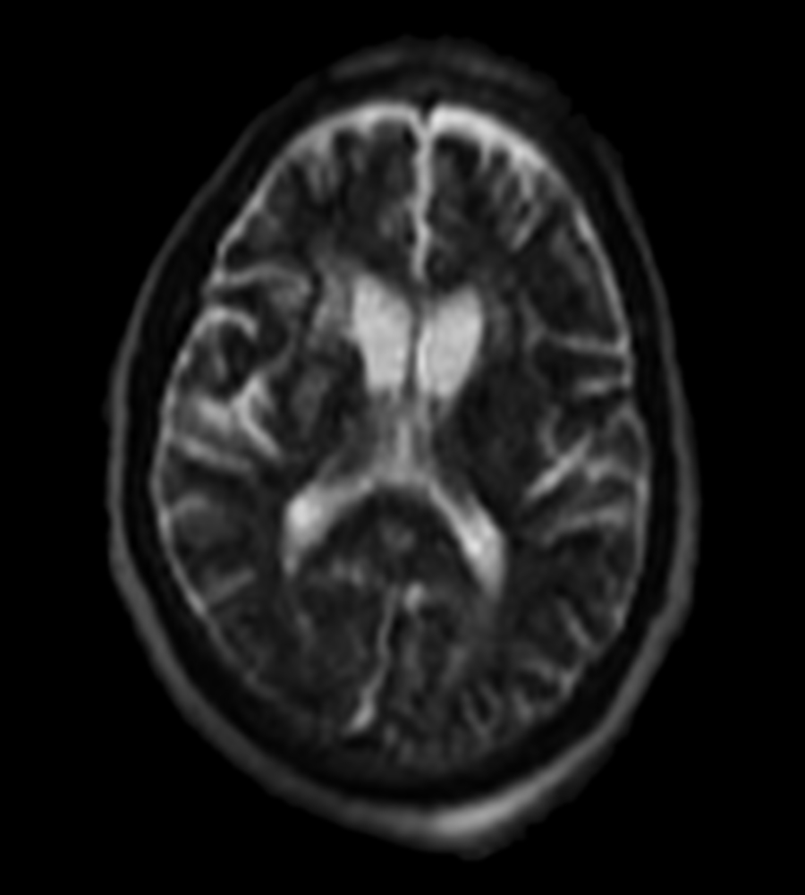
Stroke
A 56-year-old male presented in the ICU with left-sided facial droop and right-hand numbness lasting five days. Initial CT imaging revealed bilateral basal ganglia infarcts. Physicians performed bedside imaging with the Swoop® system and confirmed a new acute infarct in the right basal ganglia, while the left infarct appeared chronic.
Fast T2
Fast T2
Review images in Hyperfine, Inc. Image Viewer.
Case 027 - Stroke - 8.8 - LBL-003132 v0
Notes:
A 56-year-old male presented in the ICU with a five-day history of left-sided facial droop and numbness in his right hand. Concerned about possible cerebral events, Physicians conducted initial CT imaging, which showed bilateral infarcts in the basal ganglia. To further investigate and confirm the nature of these infarcts, they performed bedside MR imaging. Swoop® system images were used to identify a recent acute infarct in the right basal ganglia, while findings suggested the left infarct was chronic.

Slide 5
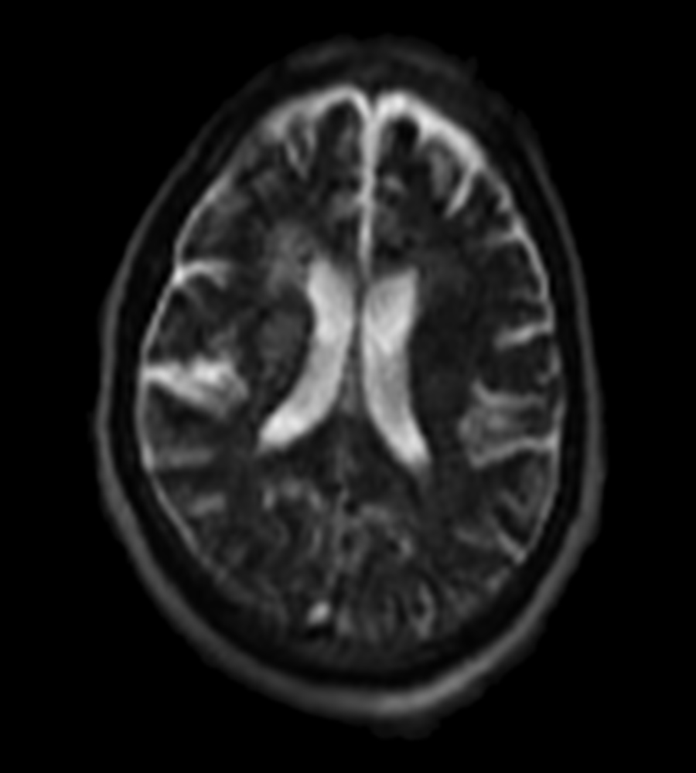
Stroke
A 56-year-old male presented in the ICU with left-sided facial droop and right-hand numbness lasting five days. Initial CT imaging revealed bilateral basal ganglia infarcts. Physicians performed bedside imaging with the Swoop® system and confirmed a new acute infarct in the right basal ganglia, while the left infarct appeared chronic.
Fast T2
Review images in Hyperfine, Inc. Image Viewer.
Case 027 - Stroke - 8.8 - LBL-003132 v0
Notes:
A 56-year-old male presented in the ICU with a five-day history of left-sided facial droop and numbness in his right hand. Concerned about possible cerebral events, Physicians conducted initial CT imaging, which showed bilateral infarcts in the basal ganglia. To further investigate and confirm the nature of these infarcts, they performed bedside MR imaging. Swoop® system images were used to identify a recent acute infarct in the right basal ganglia, while findings suggested the left infarct was chronic.

Slide 6
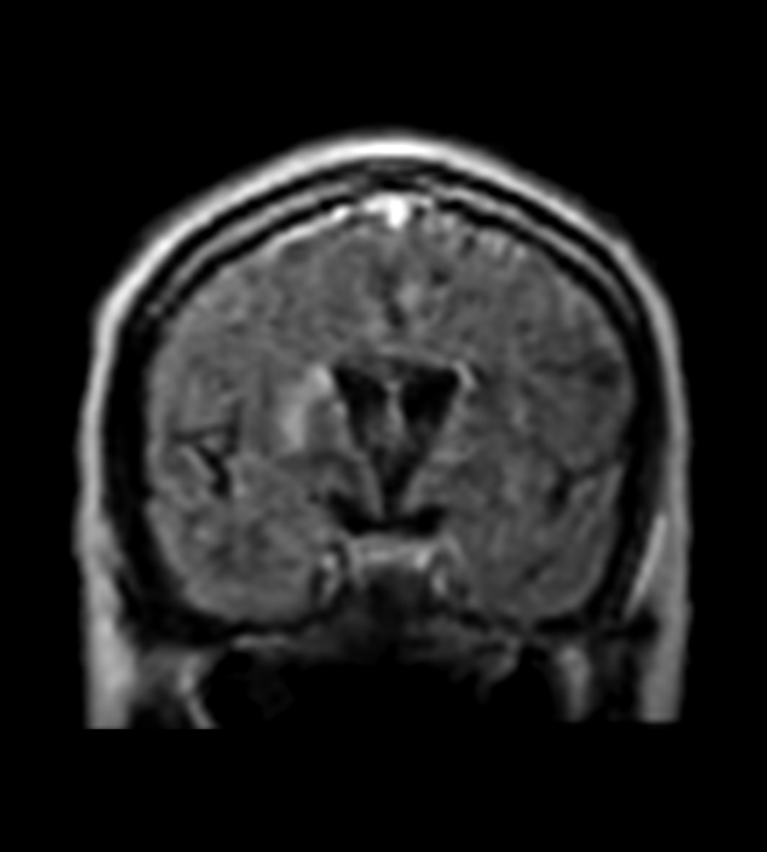
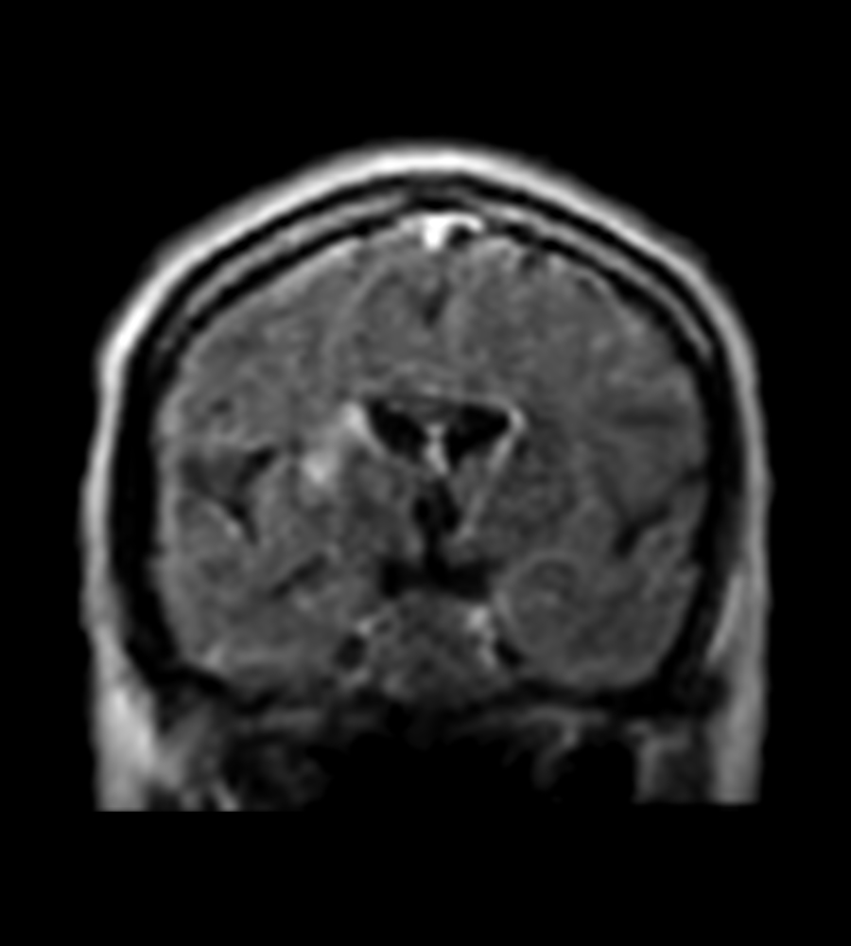
Stroke
A 56-year-old male presented in the ICU with left-sided facial droop and right-hand numbness lasting five days. Initial CT imaging revealed bilateral basal ganglia infarcts. Physicians performed bedside imaging with the Swoop® system and confirmed a new acute infarct in the right basal ganglia, while the left infarct appeared chronic.
FLAIR (Coronal)
FLAIR (Coronal)
Review images in Hyperfine, Inc. Image Viewer.
Case 027 - Stroke - 8.8 - LBL-003132 v0
Notes:
A 56-year-old male presented in the ICU with a five-day history of left-sided facial droop and numbness in his right hand. Concerned about possible cerebral events, Physicians conducted initial CT imaging, which showed bilateral infarcts in the basal ganglia. To further investigate and confirm the nature of these infarcts, they performed bedside MR imaging. Swoop® system images were used to identify a recent acute infarct in the right basal ganglia, while findings suggested the left infarct was chronic.

Slide 7
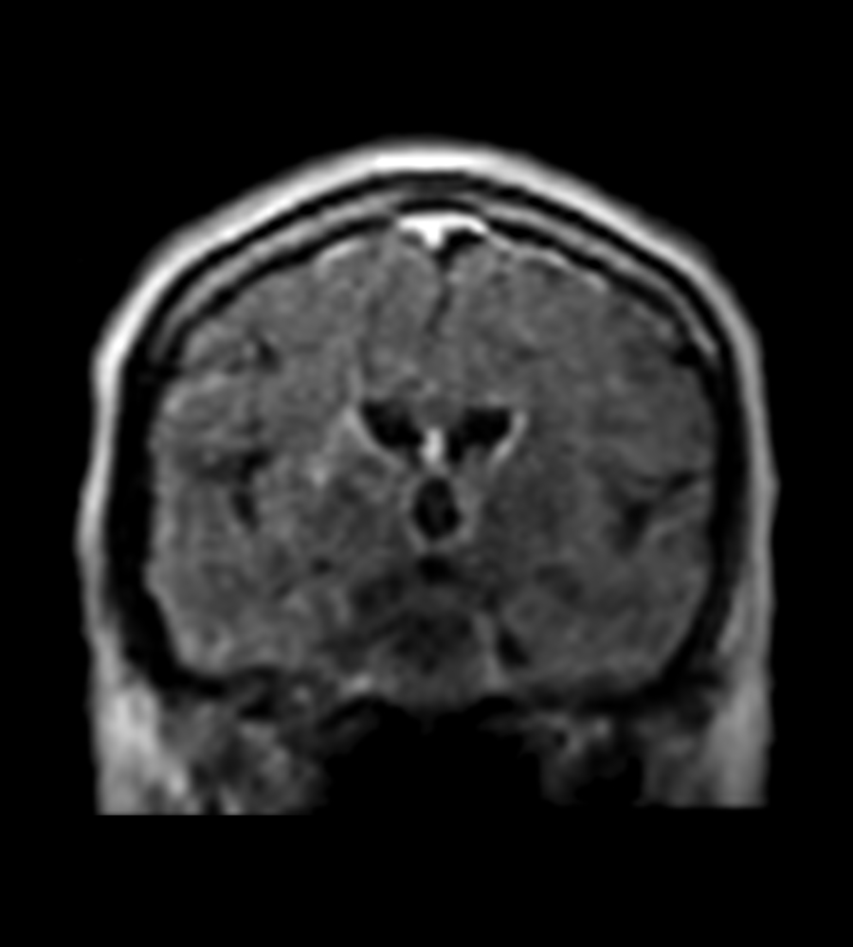
Stroke
A 56-year-old male presented in the ICU with left-sided facial droop and right-hand numbness lasting five days. Initial CT imaging revealed bilateral basal ganglia infarcts. Physicians performed bedside imaging with the Swoop® system and confirmed a new acute infarct in the right basal ganglia, while the left infarct appeared chronic.
FLAIR (Coronal)
Review images in Hyperfine, Inc. Image Viewer.
Case 027 - Stroke - 8.8 - LBL-003132 v0
Notes:
A 56-year-old male presented in the ICU with a five-day history of left-sided facial droop and numbness in his right hand. Concerned about possible cerebral events, Physicians conducted initial CT imaging, which showed bilateral infarcts in the basal ganglia. To further investigate and confirm the nature of these infarcts, they performed bedside MR imaging. Swoop® system images were used to identify a recent acute infarct in the right basal ganglia, while findings suggested the left infarct was chronic.

Slide 8
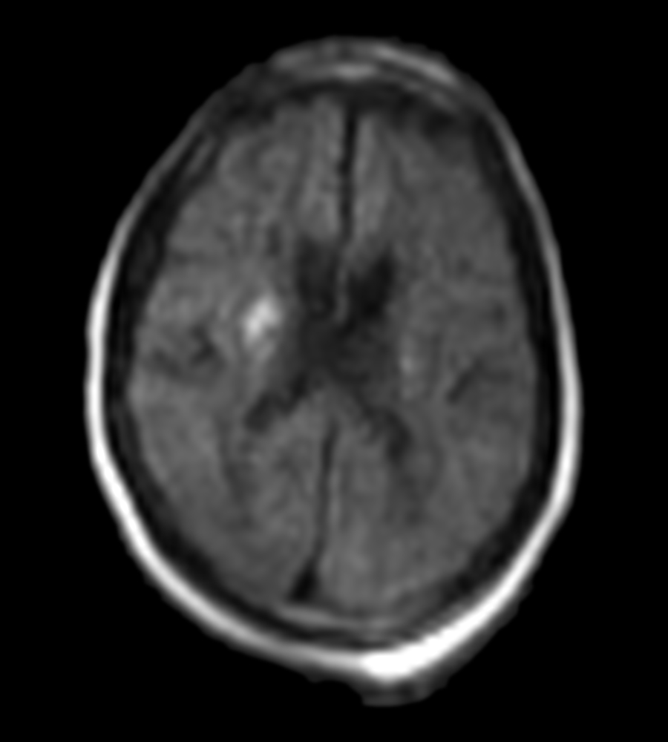
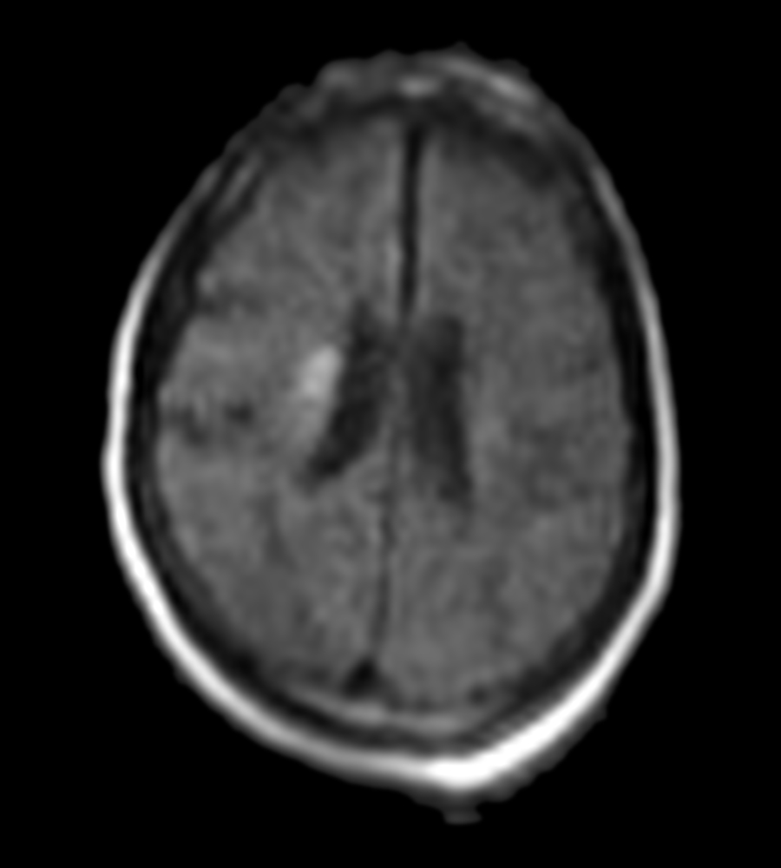
Stroke
A 56-year-old male presented in the ICU with left-sided facial droop and right-hand numbness lasting five days. Initial CT imaging revealed bilateral basal ganglia infarcts. Physicians performed bedside imaging with the Swoop® system and confirmed a new acute infarct in the right basal ganglia, while the left infarct appeared chronic.
DWI
DWI
Review images in Hyperfine, Inc. Image Viewer.
Case 027 - Stroke - 8.8 - LBL-003132 v0
Notes:
A 56-year-old male presented in the ICU with a five-day history of left-sided facial droop and numbness in his right hand. Concerned about possible cerebral events, Physicians conducted initial CT imaging, which showed bilateral infarcts in the basal ganglia. To further investigate and confirm the nature of these infarcts, they performed bedside MR imaging. Swoop® system images were used to identify a recent acute infarct in the right basal ganglia, while findings suggested the left infarct was chronic.

Slide 9
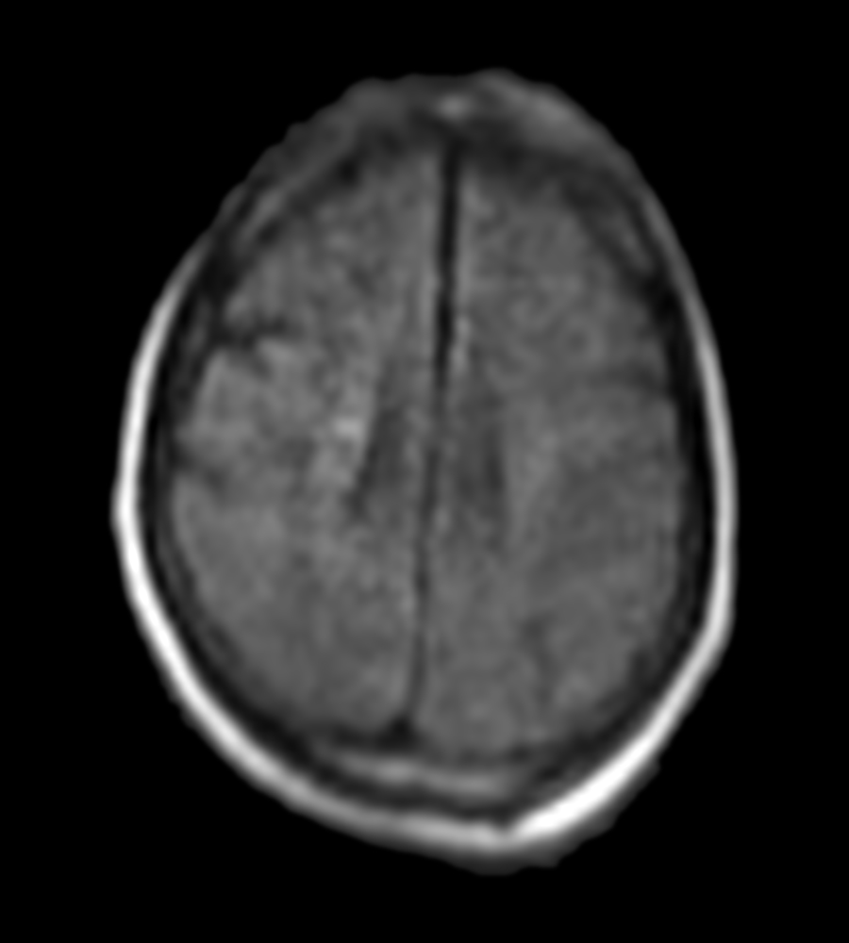
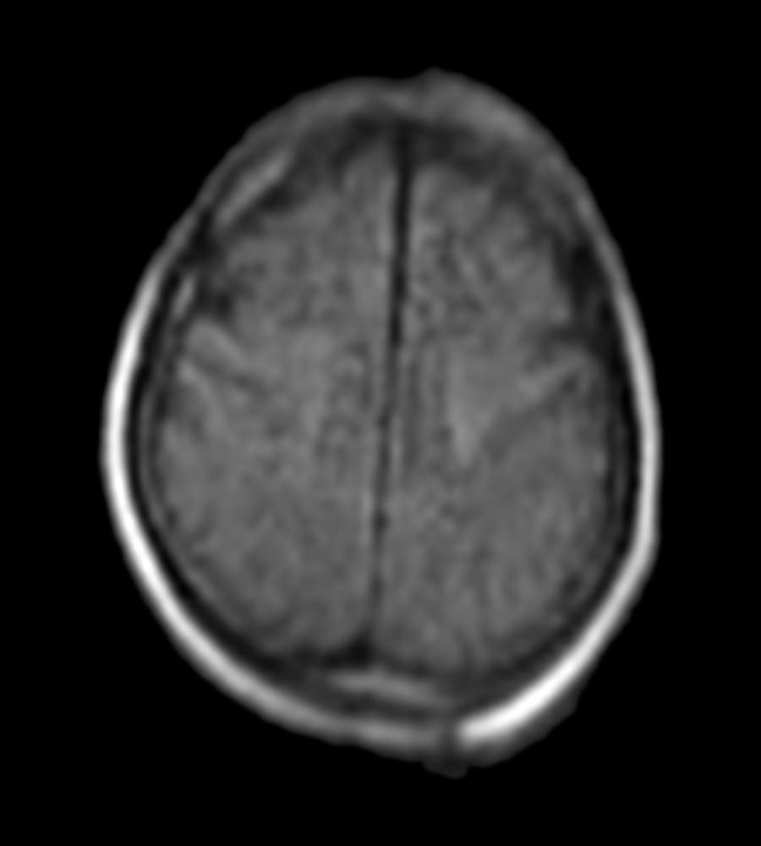
Stroke
A 56-year-old male presented in the ICU with left-sided facial droop and right-hand numbness lasting five days. Initial CT imaging revealed bilateral basal ganglia infarcts. Physicians performed bedside imaging with the Swoop® system and confirmed a new acute infarct in the right basal ganglia, while the left infarct appeared chronic.
DWI
DWI
Review images in Hyperfine, Inc. Image Viewer.
Case 027 - Stroke - 8.8 - LBL-003132 v0
Notes:
A 56-year-old male presented in the ICU with a five-day history of left-sided facial droop and numbness in his right hand. Concerned about possible cerebral events, Physicians conducted initial CT imaging, which showed bilateral infarcts in the basal ganglia. To further investigate and confirm the nature of these infarcts, they performed bedside MR imaging. Swoop® system images were used to identify a recent acute infarct in the right basal ganglia, while findings suggested the left infarct was chronic.

Slide 10
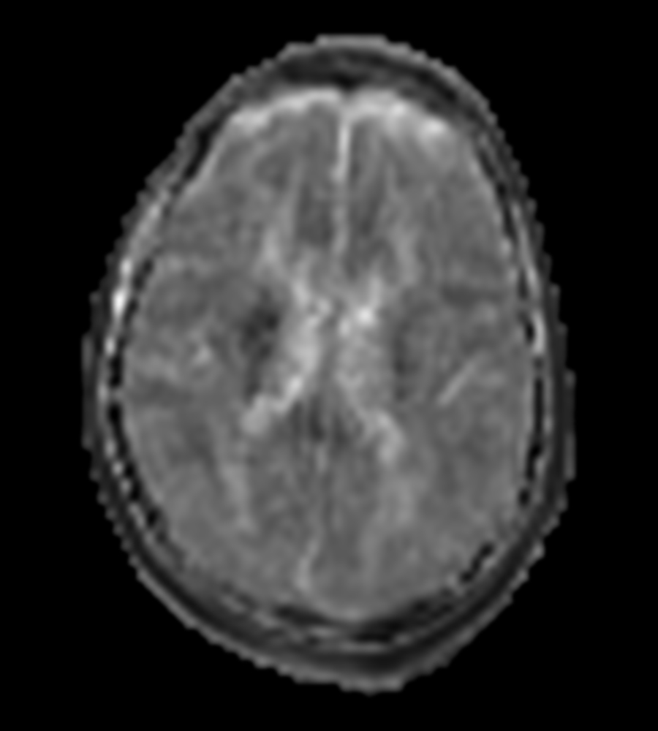
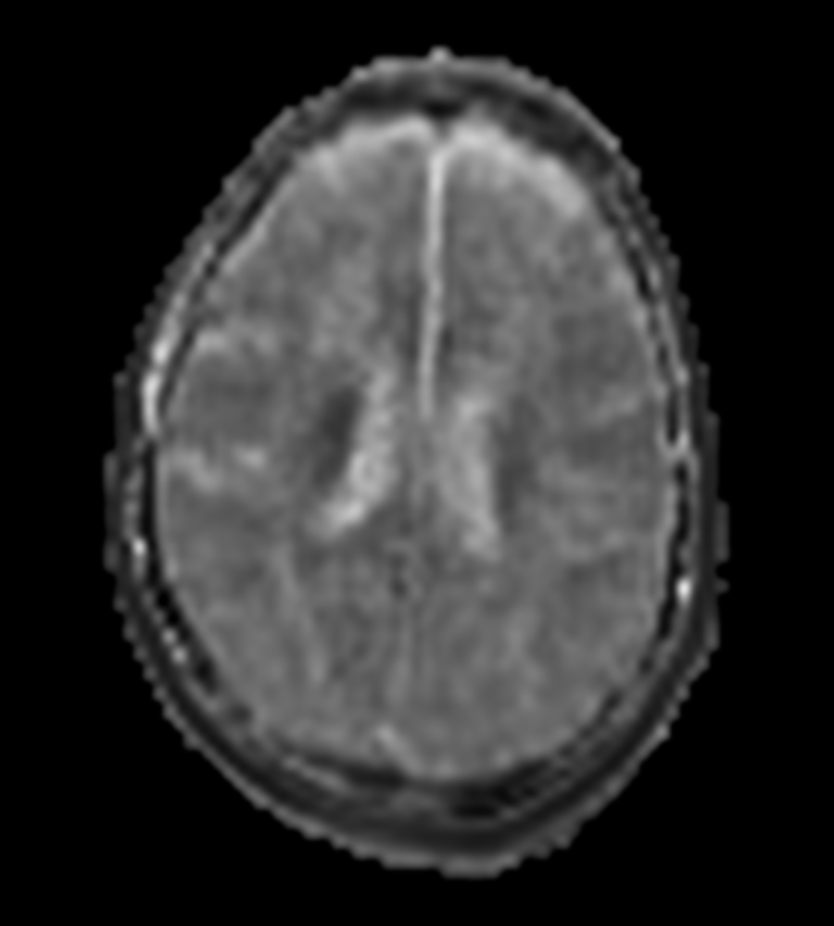
Stroke
A 56-year-old male presented in the ICU with left-sided facial droop and right-hand numbness lasting five days. Initial CT imaging revealed bilateral basal ganglia infarcts. Physicians performed bedside imaging with the Swoop® system and confirmed a new acute infarct in the right basal ganglia, while the left infarct appeared chronic.
ADC
ADC
Review images in Hyperfine, Inc. Image Viewer.
Case 027 - Stroke - 8.8 - LBL-003132 v0
Notes:
A 56-year-old male presented in the ICU with a five-day history of left-sided facial droop and numbness in his right hand. Concerned about possible cerebral events, Physicians conducted initial CT imaging, which showed bilateral infarcts in the basal ganglia. To further investigate and confirm the nature of these infarcts, they performed bedside MR imaging. Swoop® system images were used to identify a recent acute infarct in the right basal ganglia, while findings suggested the left infarct was chronic.

Slide 11
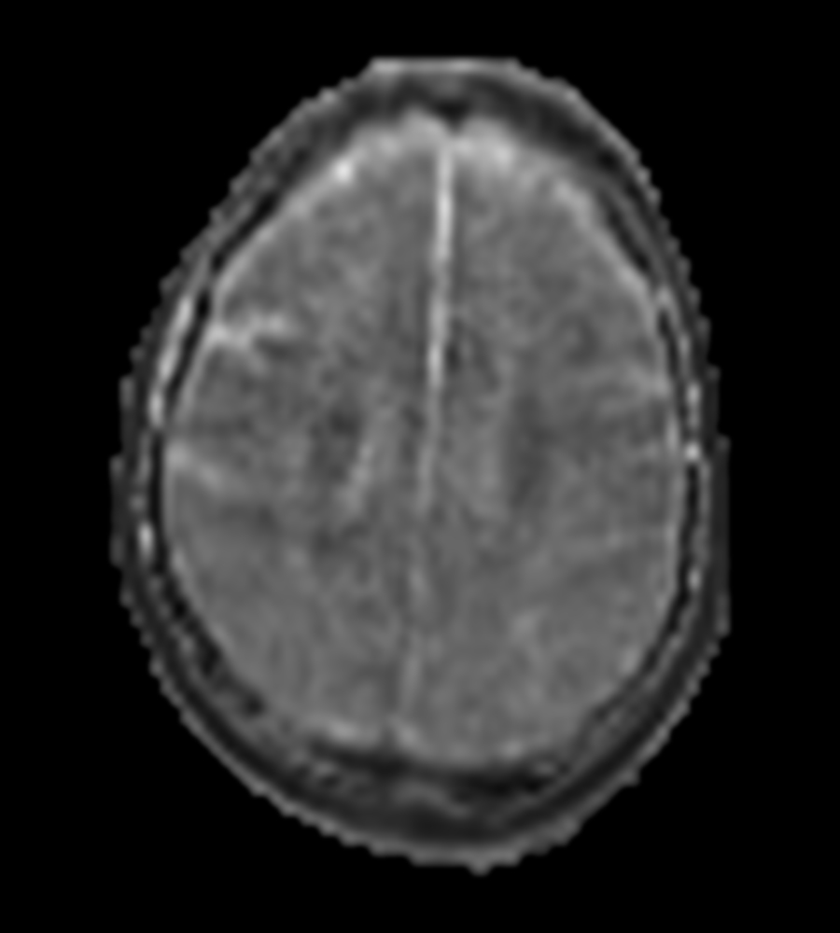
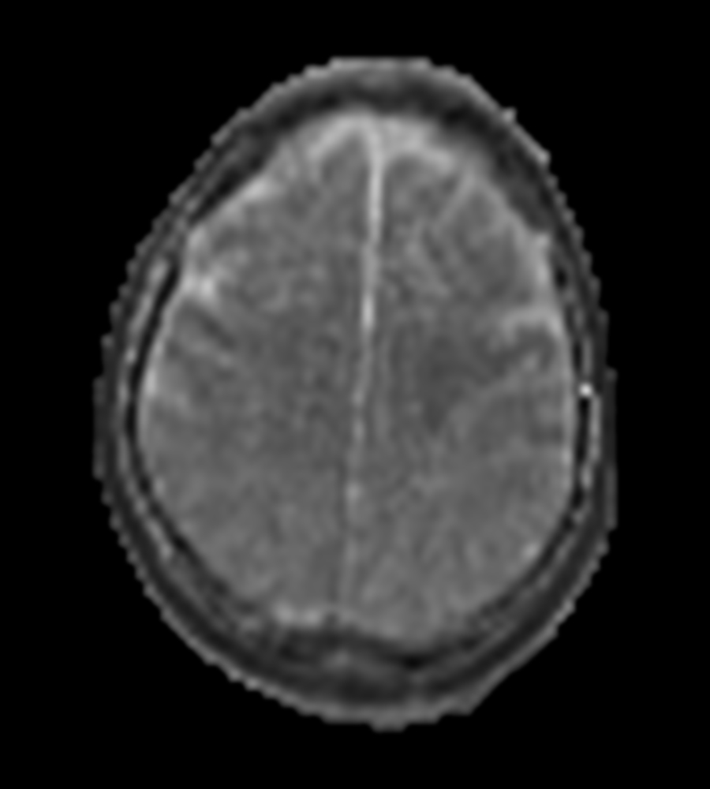
Stroke
A 56-year-old male presented in the ICU with left-sided facial droop and right-hand numbness lasting five days. Initial CT imaging revealed bilateral basal ganglia infarcts. Physicians performed bedside imaging with the Swoop® system and confirmed a new acute infarct in the right basal ganglia, while the left infarct appeared chronic.
ADC
ADC
Review images in Hyperfine, Inc. Image Viewer.
Case 027 - Stroke - 8.8 - LBL-003132 v0
Notes:
A 56-year-old male presented in the ICU with a five-day history of left-sided facial droop and numbness in his right hand. Concerned about possible cerebral events, Physicians conducted initial CT imaging, which showed bilateral infarcts in the basal ganglia. To further investigate and confirm the nature of these infarcts, they performed bedside MR imaging. Swoop® system images were used to identify a recent acute infarct in the right basal ganglia, while findings suggested the left infarct was chronic.

Slide 12
Stroke:
FLAIR
FLAIR
A 56-year-old male presented in the ICU with left-sided facial droop and right-hand numbness lasting five days. Initial CT imaging revealed bilateral basal ganglia infarcts. Physicians performed bedside imaging with the Swoop® system and confirmed a new acute infarct in the right basal ganglia, while the left infarct appeared chronic.
Review images in Hyperfine, Inc. Image Viewer.
Case 027 - Stroke - 8.8 - LBL-003132 v0
Notes:
A 56-year-old male presented in the ICU with a five-day history of left-sided facial droop and numbness in his right hand. Concerned about possible cerebral events, Physicians conducted initial CT imaging, which showed bilateral infarcts in the basal ganglia. To further investigate and confirm the nature of these infarcts, they performed bedside MR imaging. Swoop® system images were used to identify a recent acute infarct in the right basal ganglia, while findings suggested the left infarct was chronic.

Slide 13
Stroke:
FLAIR
FLAIR
A 56-year-old male presented in the ICU with left-sided facial droop and right-hand numbness lasting five days. Initial CT imaging revealed bilateral basal ganglia infarcts. Physicians performed bedside imaging with the Swoop® system and confirmed a new acute infarct in the right basal ganglia, while the left infarct appeared chronic.
Review images in Hyperfine, Inc. Image Viewer.
Case 027 - Stroke - 8.8 - LBL-003132 v0
Notes:
A 56-year-old male presented in the ICU with a five-day history of left-sided facial droop and numbness in his right hand. Concerned about possible cerebral events, Physicians conducted initial CT imaging, which showed bilateral infarcts in the basal ganglia. To further investigate and confirm the nature of these infarcts, they performed bedside MR imaging. Swoop® system images were used to identify a recent acute infarct in the right basal ganglia, while findings suggested the left infarct was chronic.

Slide 14
Stroke:
FLAIR
FLAIR
A 56-year-old male presented in the ICU with left-sided facial droop and right-hand numbness lasting five days. Initial CT imaging revealed bilateral basal ganglia infarcts. Physicians performed bedside imaging with the Swoop® system and confirmed a new acute infarct in the right basal ganglia, while the left infarct appeared chronic.
Review images in Hyperfine, Inc. Image Viewer.
Case 027 - Stroke - 8.8 - LBL-003132 v0
Notes:
A 56-year-old male presented in the ICU with a five-day history of left-sided facial droop and numbness in his right hand. Concerned about possible cerebral events, Physicians conducted initial CT imaging, which showed bilateral infarcts in the basal ganglia. To further investigate and confirm the nature of these infarcts, they performed bedside MR imaging. Swoop® system images were used to identify a recent acute infarct in the right basal ganglia, while findings suggested the left infarct was chronic.

Slide 15
Stroke:
Fast T2
Fast T2
A 56-year-old male presented in the ICU with left-sided facial droop and right-hand numbness lasting five days. Initial CT imaging revealed bilateral basal ganglia infarcts. Physicians performed bedside imaging with the Swoop® system and confirmed a new acute infarct in the right basal ganglia, while the left infarct appeared chronic.
Review images in Hyperfine, Inc. Image Viewer.
Case 027 - Stroke - 8.8 - LBL-003132 v0
Notes:
A 56-year-old male presented in the ICU with a five-day history of left-sided facial droop and numbness in his right hand. Concerned about possible cerebral events, Physicians conducted initial CT imaging, which showed bilateral infarcts in the basal ganglia. To further investigate and confirm the nature of these infarcts, they performed bedside MR imaging. Swoop® system images were used to identify a recent acute infarct in the right basal ganglia, while findings suggested the left infarct was chronic.

Slide 16
Stroke:
Fast T2
Fast T2
A 56-year-old male presented in the ICU with left-sided facial droop and right-hand numbness lasting five days. Initial CT imaging revealed bilateral basal ganglia infarcts. Physicians performed bedside imaging with the Swoop® system and confirmed a new acute infarct in the right basal ganglia, while the left infarct appeared chronic.
Review images in Hyperfine, Inc. Image Viewer.
Case 027 - Stroke - 8.8 - LBL-003132 v0
Notes:
A 56-year-old male presented in the ICU with a five-day history of left-sided facial droop and numbness in his right hand. Concerned about possible cerebral events, Physicians conducted initial CT imaging, which showed bilateral infarcts in the basal ganglia. To further investigate and confirm the nature of these infarcts, they performed bedside MR imaging. Swoop® system images were used to identify a recent acute infarct in the right basal ganglia, while findings suggested the left infarct was chronic.

Slide 17
Stroke:
Fast T2
Fast T2
A 56-year-old male presented in the ICU with left-sided facial droop and right-hand numbness lasting five days. Initial CT imaging revealed bilateral basal ganglia infarcts. Physicians performed bedside imaging with the Swoop® system and confirmed a new acute infarct in the right basal ganglia, while the left infarct appeared chronic.
Review images in Hyperfine, Inc. Image Viewer.
Case 027 - Stroke - 8.8 - LBL-003132 v0
Notes:
A 56-year-old male presented in the ICU with a five-day history of left-sided facial droop and numbness in his right hand. Concerned about possible cerebral events, Physicians conducted initial CT imaging, which showed bilateral infarcts in the basal ganglia. To further investigate and confirm the nature of these infarcts, they performed bedside MR imaging. Swoop® system images were used to identify a recent acute infarct in the right basal ganglia, while findings suggested the left infarct was chronic.

Slide 18
Stroke:
FLAIR (Coronal)
FLAIR (Coronal)
A 56-year-old male presented in the ICU with left-sided facial droop and right-hand numbness lasting five days. Initial CT imaging revealed bilateral basal ganglia infarcts. Physicians performed bedside imaging with the Swoop® system and confirmed a new acute infarct in the right basal ganglia, while the left infarct appeared chronic.
Review images in Hyperfine, Inc. Image Viewer.
Case 027 - Stroke - 8.8 - LBL-003132 v0
Notes:
A 56-year-old male presented in the ICU with a five-day history of left-sided facial droop and numbness in his right hand. Concerned about possible cerebral events, Physicians conducted initial CT imaging, which showed bilateral infarcts in the basal ganglia. To further investigate and confirm the nature of these infarcts, they performed bedside MR imaging. Swoop® system images were used to identify a recent acute infarct in the right basal ganglia, while findings suggested the left infarct was chronic.

Slide 19
Stroke:
FLAIR (Coronal)
FLAIR (Coronal)
A 56-year-old male presented in the ICU with left-sided facial droop and right-hand numbness lasting five days. Initial CT imaging revealed bilateral basal ganglia infarcts. Physicians performed bedside imaging with the Swoop® system and confirmed a new acute infarct in the right basal ganglia, while the left infarct appeared chronic.
Review images in Hyperfine, Inc. Image Viewer.
Case 027 - Stroke - 8.8 - LBL-003132 v0
Notes:
A 56-year-old male presented in the ICU with a five-day history of left-sided facial droop and numbness in his right hand. Concerned about possible cerebral events, Physicians conducted initial CT imaging, which showed bilateral infarcts in the basal ganglia. To further investigate and confirm the nature of these infarcts, they performed bedside MR imaging. Swoop® system images were used to identify a recent acute infarct in the right basal ganglia, while findings suggested the left infarct was chronic.

Slide 20
Stroke:
FLAIR (Coronal)
FLAIR (Coronal)
A 56-year-old male presented in the ICU with left-sided facial droop and right-hand numbness lasting five days. Initial CT imaging revealed bilateral basal ganglia infarcts. Physicians performed bedside imaging with the Swoop® system and confirmed a new acute infarct in the right basal ganglia, while the left infarct appeared chronic.
Review images in Hyperfine, Inc. Image Viewer.
Case 027 - Stroke - 8.8 - LBL-003132 v0
Notes:
A 56-year-old male presented in the ICU with a five-day history of left-sided facial droop and numbness in his right hand. Concerned about possible cerebral events, Physicians conducted initial CT imaging, which showed bilateral infarcts in the basal ganglia. To further investigate and confirm the nature of these infarcts, they performed bedside MR imaging. Swoop® system images were used to identify a recent acute infarct in the right basal ganglia, while findings suggested the left infarct was chronic.

Slide 21
Stroke:
DWI
DWI
A 56-year-old male presented in the ICU with left-sided facial droop and right-hand numbness lasting five days. Initial CT imaging revealed bilateral basal ganglia infarcts. Physicians performed bedside imaging with the Swoop® system and confirmed a new acute infarct in the right basal ganglia, while the left infarct appeared chronic.
Review images in Hyperfine, Inc. Image Viewer.
Case 027 - Stroke - 8.8 - LBL-003132 v0
Notes:
A 56-year-old male presented in the ICU with a five-day history of left-sided facial droop and numbness in his right hand. Concerned about possible cerebral events, Physicians conducted initial CT imaging, which showed bilateral infarcts in the basal ganglia. To further investigate and confirm the nature of these infarcts, they performed bedside MR imaging. Swoop® system images were used to identify a recent acute infarct in the right basal ganglia, while findings suggested the left infarct was chronic.

Slide 22
Stroke:
DWI
DWI
A 56-year-old male presented in the ICU with left-sided facial droop and right-hand numbness lasting five days. Initial CT imaging revealed bilateral basal ganglia infarcts. Physicians performed bedside imaging with the Swoop® system and confirmed a new acute infarct in the right basal ganglia, while the left infarct appeared chronic.
Review images in Hyperfine, Inc. Image Viewer.
Case 027 - Stroke - 8.8 - LBL-003132 v0
Notes:
A 56-year-old male presented in the ICU with a five-day history of left-sided facial droop and numbness in his right hand. Concerned about possible cerebral events, Physicians conducted initial CT imaging, which showed bilateral infarcts in the basal ganglia. To further investigate and confirm the nature of these infarcts, they performed bedside MR imaging. Swoop® system images were used to identify a recent acute infarct in the right basal ganglia, while findings suggested the left infarct was chronic.

Slide 23
Stroke:
DWI
DWI
A 56-year-old male presented in the ICU with left-sided facial droop and right-hand numbness lasting five days. Initial CT imaging revealed bilateral basal ganglia infarcts. Physicians performed bedside imaging with the Swoop® system and confirmed a new acute infarct in the right basal ganglia, while the left infarct appeared chronic.
Review images in Hyperfine, Inc. Image Viewer.
Case 027 - Stroke - 8.8 - LBL-003132 v0
Notes:
A 56-year-old male presented in the ICU with a five-day history of left-sided facial droop and numbness in his right hand. Concerned about possible cerebral events, Physicians conducted initial CT imaging, which showed bilateral infarcts in the basal ganglia. To further investigate and confirm the nature of these infarcts, they performed bedside MR imaging. Swoop® system images were used to identify a recent acute infarct in the right basal ganglia, while findings suggested the left infarct was chronic.

Slide 24
Stroke:
DWI
DWI
A 56-year-old male presented in the ICU with left-sided facial droop and right-hand numbness lasting five days. Initial CT imaging revealed bilateral basal ganglia infarcts. Physicians performed bedside imaging with the Swoop® system and confirmed a new acute infarct in the right basal ganglia, while the left infarct appeared chronic.
Review images in Hyperfine, Inc. Image Viewer.
Case 027 - Stroke - 8.8 - LBL-003132 v0
Notes:
A 56-year-old male presented in the ICU with a five-day history of left-sided facial droop and numbness in his right hand. Concerned about possible cerebral events, Physicians conducted initial CT imaging, which showed bilateral infarcts in the basal ganglia. To further investigate and confirm the nature of these infarcts, they performed bedside MR imaging. Swoop® system images were used to identify a recent acute infarct in the right basal ganglia, while findings suggested the left infarct was chronic.

Slide 25
Stroke:
ADC
ADC
A 56-year-old male presented in the ICU with left-sided facial droop and right-hand numbness lasting five days. Initial CT imaging revealed bilateral basal ganglia infarcts. Physicians performed bedside imaging with the Swoop® system and confirmed a new acute infarct in the right basal ganglia, while the left infarct appeared chronic.
Review images in Hyperfine, Inc. Image Viewer.
Case 027 - Stroke - 8.8 - LBL-003132 v0
Notes:
A 56-year-old male presented in the ICU with a five-day history of left-sided facial droop and numbness in his right hand. Concerned about possible cerebral events, Physicians conducted initial CT imaging, which showed bilateral infarcts in the basal ganglia. To further investigate and confirm the nature of these infarcts, they performed bedside MR imaging. Swoop® system images were used to identify a recent acute infarct in the right basal ganglia, while findings suggested the left infarct was chronic.

Slide 26
Stroke:
ADC
ADC
A 56-year-old male presented in the ICU with left-sided facial droop and right-hand numbness lasting five days. Initial CT imaging revealed bilateral basal ganglia infarcts. Physicians performed bedside imaging with the Swoop® system and confirmed a new acute infarct in the right basal ganglia, while the left infarct appeared chronic.
Review images in Hyperfine, Inc. Image Viewer.
Case 027 - Stroke - 8.8 - LBL-003132 v0
Notes:
A 56-year-old male presented in the ICU with a five-day history of left-sided facial droop and numbness in his right hand. Concerned about possible cerebral events, Physicians conducted initial CT imaging, which showed bilateral infarcts in the basal ganglia. To further investigate and confirm the nature of these infarcts, they performed bedside MR imaging. Swoop® system images were used to identify a recent acute infarct in the right basal ganglia, while findings suggested the left infarct was chronic.

Slide 27
Stroke:
ADC
ADC
A 56-year-old male presented in the ICU with left-sided facial droop and right-hand numbness lasting five days. Initial CT imaging revealed bilateral basal ganglia infarcts. Physicians performed bedside imaging with the Swoop® system and confirmed a new acute infarct in the right basal ganglia, while the left infarct appeared chronic.
Review images in Hyperfine, Inc. Image Viewer.
Case 027 - Stroke - 8.8 - LBL-003132 v0
Notes:
A 56-year-old male presented in the ICU with a five-day history of left-sided facial droop and numbness in his right hand. Concerned about possible cerebral events, Physicians conducted initial CT imaging, which showed bilateral infarcts in the basal ganglia. To further investigate and confirm the nature of these infarcts, they performed bedside MR imaging. Swoop® system images were used to identify a recent acute infarct in the right basal ganglia, while findings suggested the left infarct was chronic.

Slide 28
Stroke:
ADC
ADC
A 56-year-old male presented in the ICU with left-sided facial droop and right-hand numbness lasting five days. Initial CT imaging revealed bilateral basal ganglia infarcts. Physicians performed bedside imaging with the Swoop® system and confirmed a new acute infarct in the right basal ganglia, while the left infarct appeared chronic.
Review images in Hyperfine, Inc. Image Viewer.
Case 027 - Stroke - 8.8 - LBL-003132 v0
Notes:
A 56-year-old male presented in the ICU with a five-day history of left-sided facial droop and numbness in his right hand. Concerned about possible cerebral events, Physicians conducted initial CT imaging, which showed bilateral infarcts in the basal ganglia. To further investigate and confirm the nature of these infarcts, they performed bedside MR imaging. Swoop® system images were used to identify a recent acute infarct in the right basal ganglia, while findings suggested the left infarct was chronic.

Slide 29
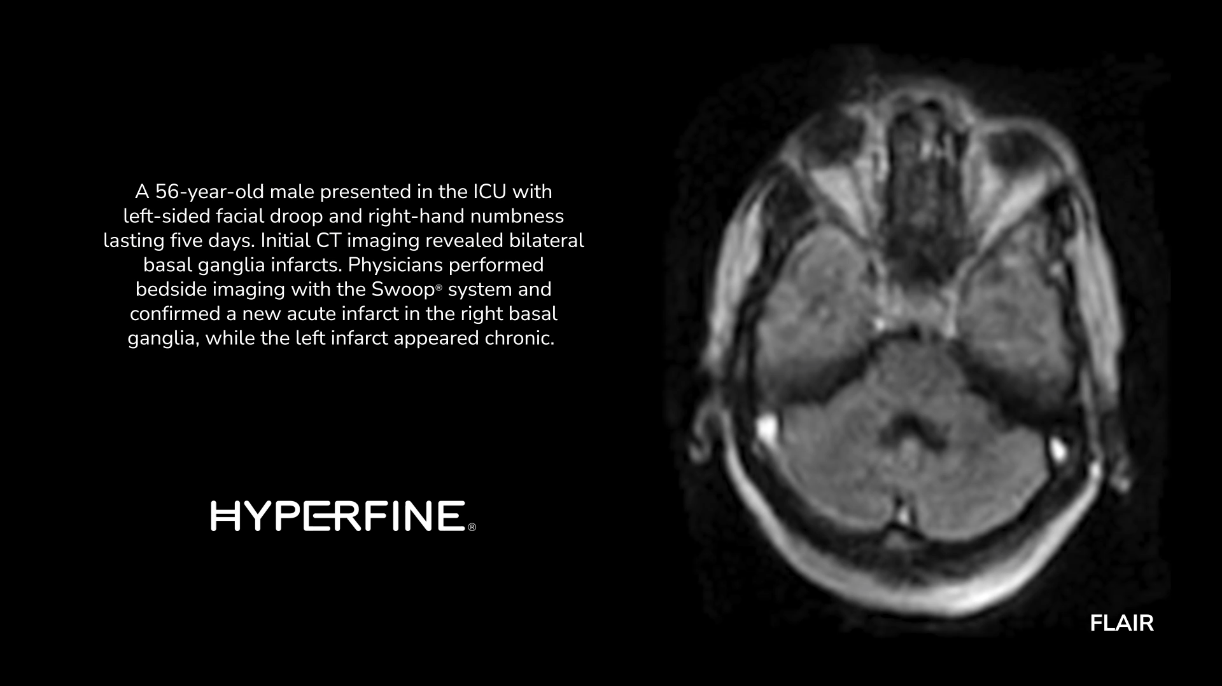
Case 027 - Stroke - 8.8 - LBL-003132 v0
Notes:
A 56-year-old male presented in the ICU with a five-day history of left-sided facial droop and numbness in his right hand. Concerned about possible cerebral events, Physicians conducted initial CT imaging, which showed bilateral infarcts in the basal ganglia. To further investigate and confirm the nature of these infarcts, they performed bedside MR imaging. Swoop® system images were used to identify a recent acute infarct in the right basal ganglia, while findings suggested the left infarct was chronic.

