Slide 1
Post-operative ICU Exam
Case
021

Slide 2
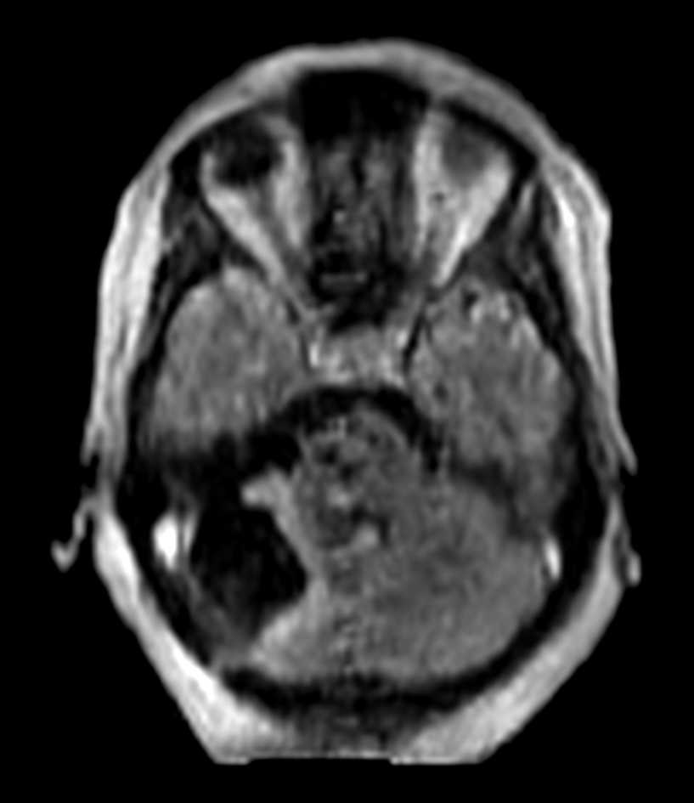
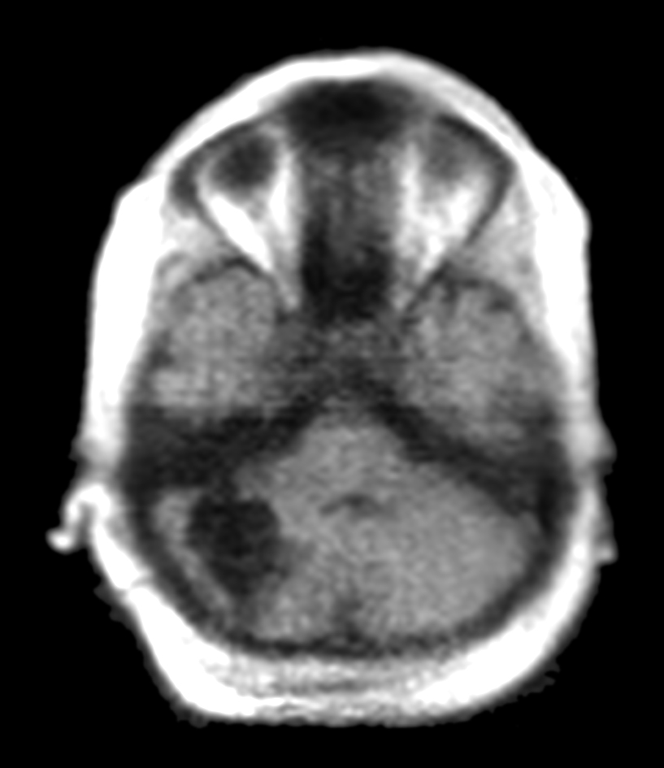
Post-operative ICU Exam
A 39-year-old female with a history of recurrent metastatic non-small cell lung carcinoma. She now presents with a growing right-sided posterior fossa mass. Physicians used the Swoop® system in the ICU twelve hours after surgery to assess her condition. The images showed a total resection with no evidence of hemorrhage, significant edema, mass effect, or obstructive hydrocephalus. Following the exam, physicians transferred the patient out of the ICU on postoperative day one, saving time and cost.
FLAIR
T1 (Standard)
Review images in Hyperfine, Inc. Image Viewer.
Case 021 - Post-operative ICU Exam - 8.6.0 - LBL-002611 v0
Notes:
A 39-year-old woman with a history of recurrent metastatic non-small cell lung carcinoma, previously treated with surgery and therapies including chemo, immuno, and radiation, faced a new challenge—a growing right-sided fossa mass. Twelve hours post-surgical resection, physicians used the Swoop® system in the ICU to evaluate her condition. The images were encouraging, showing no evidence of hemorrhage, significant edema, mass effect, or obstructive hydrocephalus. As a result, she was transferred out of the ICU on postoperative day one, saving significant time and cost.

Slide 3
Post-operative ICU Exam
A 39-year-old female with a history of recurrent metastatic non-small cell lung carcinoma. She now presents with a growing right-sided posterior fossa mass. Physicians used the Swoop® system in the ICU twelve hours after surgery to assess her condition. The images showed a total resection with no evidence of hemorrhage, significant edema, mass effect, or obstructive hydrocephalus. Following the exam, physicians transferred the patient out of the ICU on postoperative day one, saving time and cost
DWI
Review images in Hyperfine, Inc. Image Viewer.
Case 021 - Post-operative ICU Exam - 8.6.0 - LBL-002611 v0
Notes:
A 39-year-old woman with a history of recurrent metastatic non-small cell lung carcinoma, previously treated with surgery and therapies including chemo, immuno, and radiation, faced a new challenge—a growing right-sided fossa mass. Twelve hours post-surgical resection, physicians used the Swoop® system in the ICU to evaluate her condition. The images were encouraging, showing no evidence of hemorrhage, significant edema, mass effect, or obstructive hydrocephalus. As a result, she was transferred out of the ICU on postoperative day one, saving significant time and cost.

Slide 4
Post-operative ICU Exam:
FLAIR
FLAIR
A 39-year-old female with a history of recurrent metastatic non-small cell lung carcinoma. She now presents with a growing right-sided posterior fossa mass. Physicians used the Swoop® system in the ICU twelve hours after surgery to assess her condition. The images showed a total resection with no evidence of hemorrhage, significant edema, mass effect, or obstructive hydrocephalus. Following the exam, physicians transferred the patient out of the ICU on postoperative day one, saving time and cost.
Review images in Hyperfine, Inc. Image Viewer.
Case 021 - Post-operative ICU Exam - 8.6.0 - LBL-002611 v0
Notes:
A 39-year-old woman with a history of recurrent metastatic non-small cell lung carcinoma, previously treated with surgery and therapies including chemo, immuno, and radiation, faced a new challenge—a growing right-sided fossa mass. Twelve hours post-surgical resection, physicians used the Swoop® system in the ICU to evaluate her condition. The images were encouraging, showing no evidence of hemorrhage, significant edema, mass effect, or obstructive hydrocephalus. As a result, she was transferred out of the ICU on postoperative day one, saving significant time and cost.

Slide 5
Post-operative ICU Exam:
T1 (Standard)
T1 (Standard)
A 39-year-old female with a history of recurrent metastatic non-small cell lung carcinoma. She now presents with a growing right-sided posterior fossa mass. Physicians used the Swoop® system in the ICU twelve hours after surgery to assess her condition. The images showed a total resection with no evidence of hemorrhage, significant edema, mass effect, or obstructive hydrocephalus. Following the exam, physicians transferred the patient out of the ICU on postoperative day one, saving time and cost.
Review images in Hyperfine, Inc. Image Viewer.
Case 021 - Post-operative ICU Exam - 8.6.0 - LBL-002611 v0
Notes:
A 39-year-old woman with a history of recurrent metastatic non-small cell lung carcinoma, previously treated with surgery and therapies including chemo, immuno, and radiation, faced a new challenge—a growing right-sided fossa mass. Twelve hours post-surgical resection, physicians used the Swoop® system in the ICU to evaluate her condition. The images were encouraging, showing no evidence of hemorrhage, significant edema, mass effect, or obstructive hydrocephalus. As a result, she was transferred out of the ICU on postoperative day one, saving significant time and cost.

Slide 6
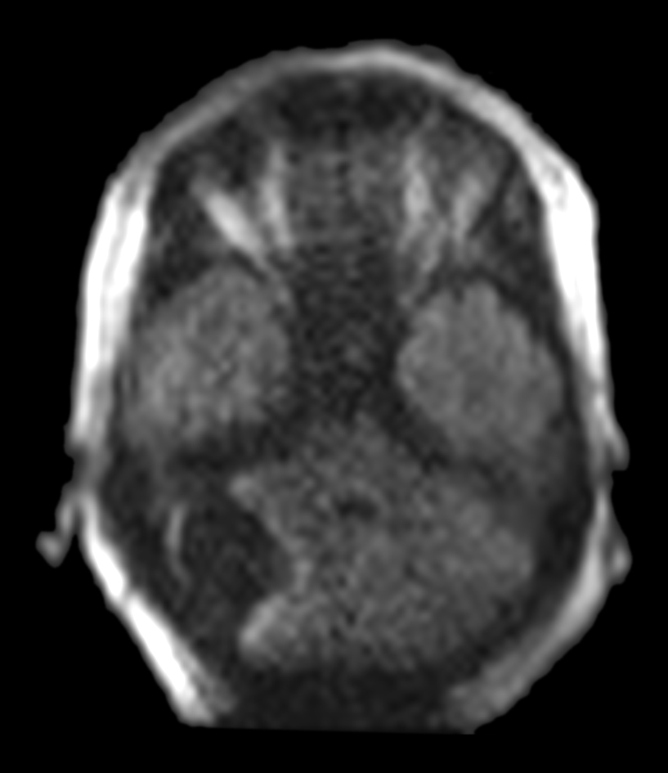
Post-operative ICU Exam:
DWI
DWI
A 39-year-old female with a history of recurrent metastatic non-small cell lung carcinoma. She now presents with a growing right-sided posterior fossa mass. Physicians used the Swoop® system in the ICU twelve hours after surgery to assess her condition. The images showed a total resection with no evidence of hemorrhage, significant edema, mass effect, or obstructive hydrocephalus. Following the exam, physicians transferred the patient out of the ICU on postoperative day one, saving time and cost.
Review images in Hyperfine, Inc. Image Viewer.
Case 021 - Post-operative ICU Exam - 8.6.0 - LBL-002611 v0
Notes:
A 39-year-old woman with a history of recurrent metastatic non-small cell lung carcinoma, previously treated with surgery and therapies including chemo, immuno, and radiation, faced a new challenge—a growing right-sided fossa mass. Twelve hours post-surgical resection, physicians used the Swoop® system in the ICU to evaluate her condition. The images were encouraging, showing no evidence of hemorrhage, significant edema, mass effect, or obstructive hydrocephalus. As a result, she was transferred out of the ICU on postoperative day one, saving significant time and cost.

Slide 7
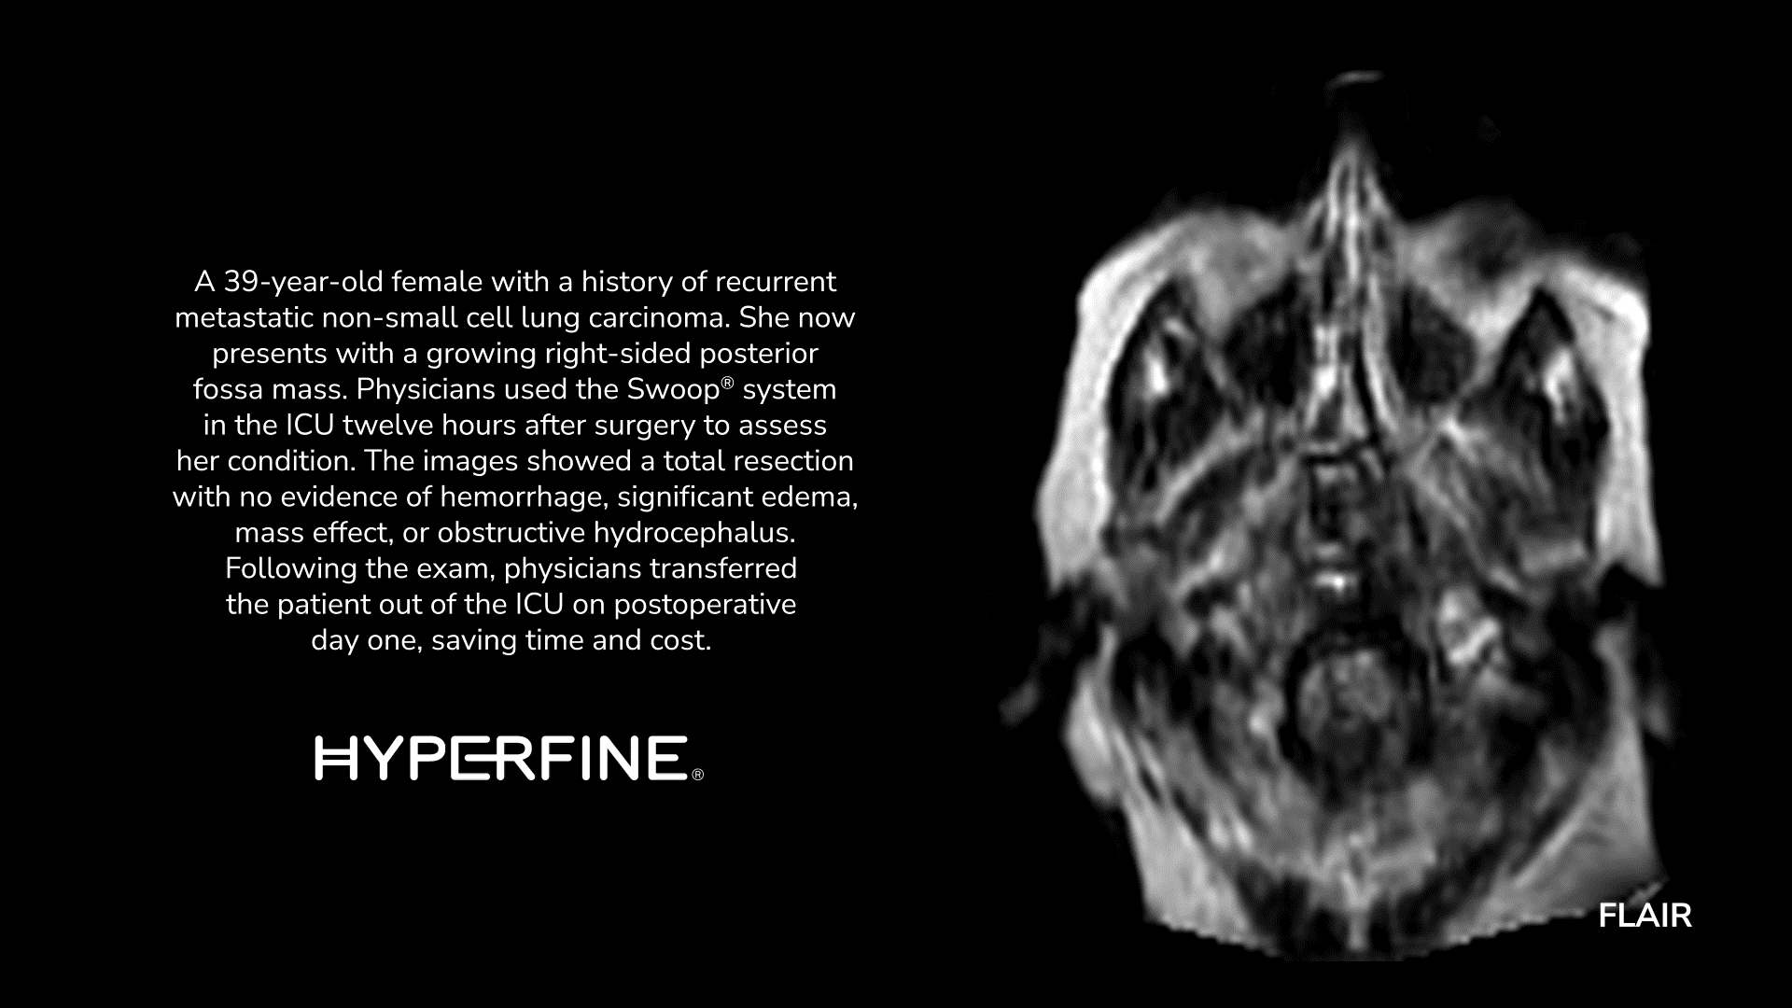
Case 021 - Post-operative ICU Exam - 8.6.0 - LBL-002611 v0
Notes:
A 39-year-old woman with a history of recurrent metastatic non-small cell lung carcinoma, previously treated with surgery and therapies including chemo, immuno, and radiation, faced a new challenge—a growing right-sided fossa mass. Twelve hours post-surgical resection, physicians used the Swoop® system in the ICU to evaluate her condition. The images were encouraging, showing no evidence of hemorrhage, significant edema, mass effect, or obstructive hydrocephalus. As a result, she was transferred out of the ICU on postoperative day one, saving significant time and cost.

