Slide 1



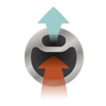
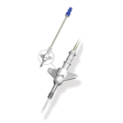
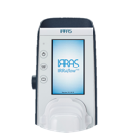
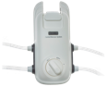

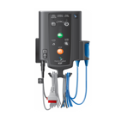
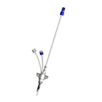
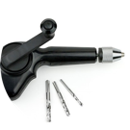
Your new leader in neurocritical care
Offering a full product portfolio from the IRRAflow and Hummingbird product lines
Current product family portfolio
IRRAflow dual-lumen catheter probe
IRRAflow Tube Set
IRRAflow Control Unit
“World’s first and only Irrigating Ventricular Drain” (IVD)
Enables interaction between control unit and probe
Controlled management of ICP and drainage via touchscreen console
Product family acquired from InnerSpace
Cranial Access Bolt
with Monitoring
Parenchymal ICP Control Module
Triple Lumen Bolt for Multimodal Monitoring (MMM)
Cranial Access Kit
Combines brain access and parenchymal ICP measurement
Connects Hummingbird disposables to ~10 different Hospital Monitors
Combines brain access, ICP measurement, drainage, and two additional lumens
Essential tools for cranial access, used in almost every neurosurgical operation
Parenchyma = Brian tissue

