Slide 1
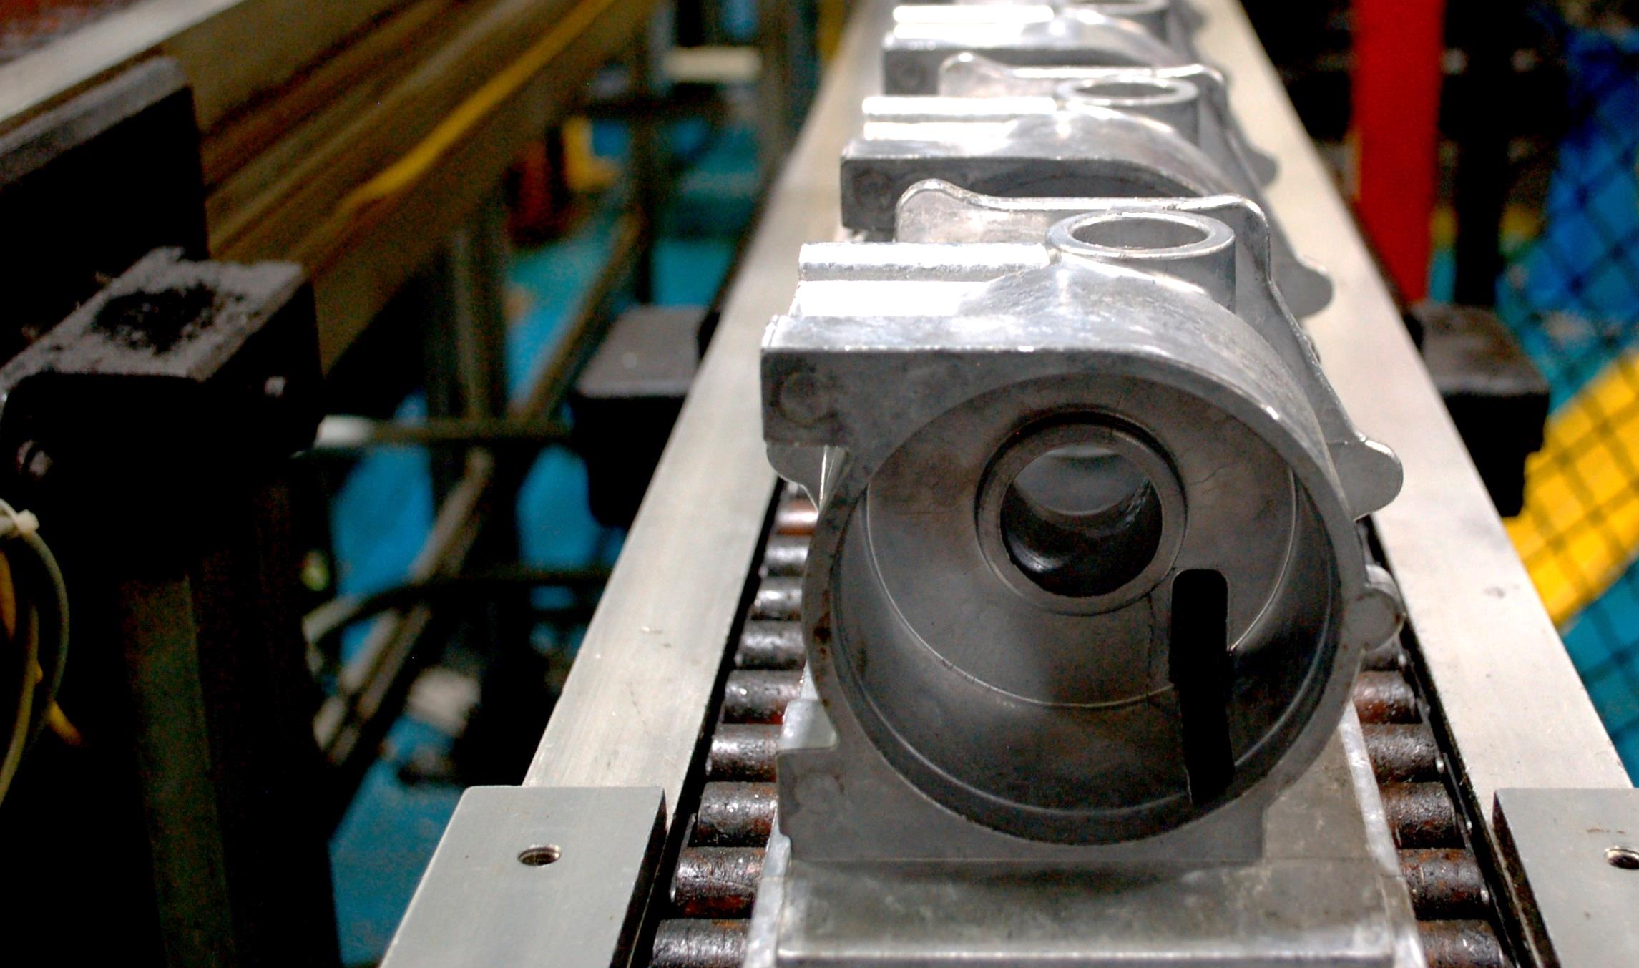

COMPANY
OVERVIEW
[DATE]
[PRESENTOR]

Slide 2



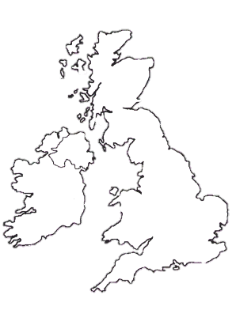

COMPANY PROFILE
EMP Headquarters
(Escanaba, MI)
Complex, mid-to-high volume machining & product engineering
Product Development
(Escanaba, MI)
Engineering, development, testing, and proprietary product/system launches
Dedicated Assembly
(Greenfield, IN)
High-to-low volume assembly needs
1981
506,000
c.450
Established
Square Feet
Employees
Ownership in 1991
Across 3 Locations
Nationwide& the UK

Slide 3
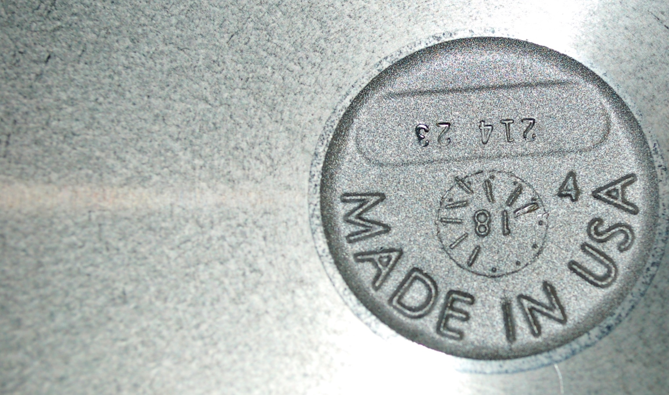
WHO WE ARE
Family owned and operated since 1991
Manufacturing & thermal solution providers
World class engineering
Cutting-edge machining & automation
International customer reach

Slide 4



WHERE WE ARE
Consumer
Products
Off-Highway
On-Highway
Other Industrial
Agriculture
Mining
Construction
Forestry
Transit Bus
Class 1-8 OTR
Refuse Vehicles
School Buses
Armored Vehicles
Commercial
Institutional
Oil & Gas
Power Generation
Military Vehicles
Marine
Rail

Slide 5












EMP CUSTOMERS

Slide 6


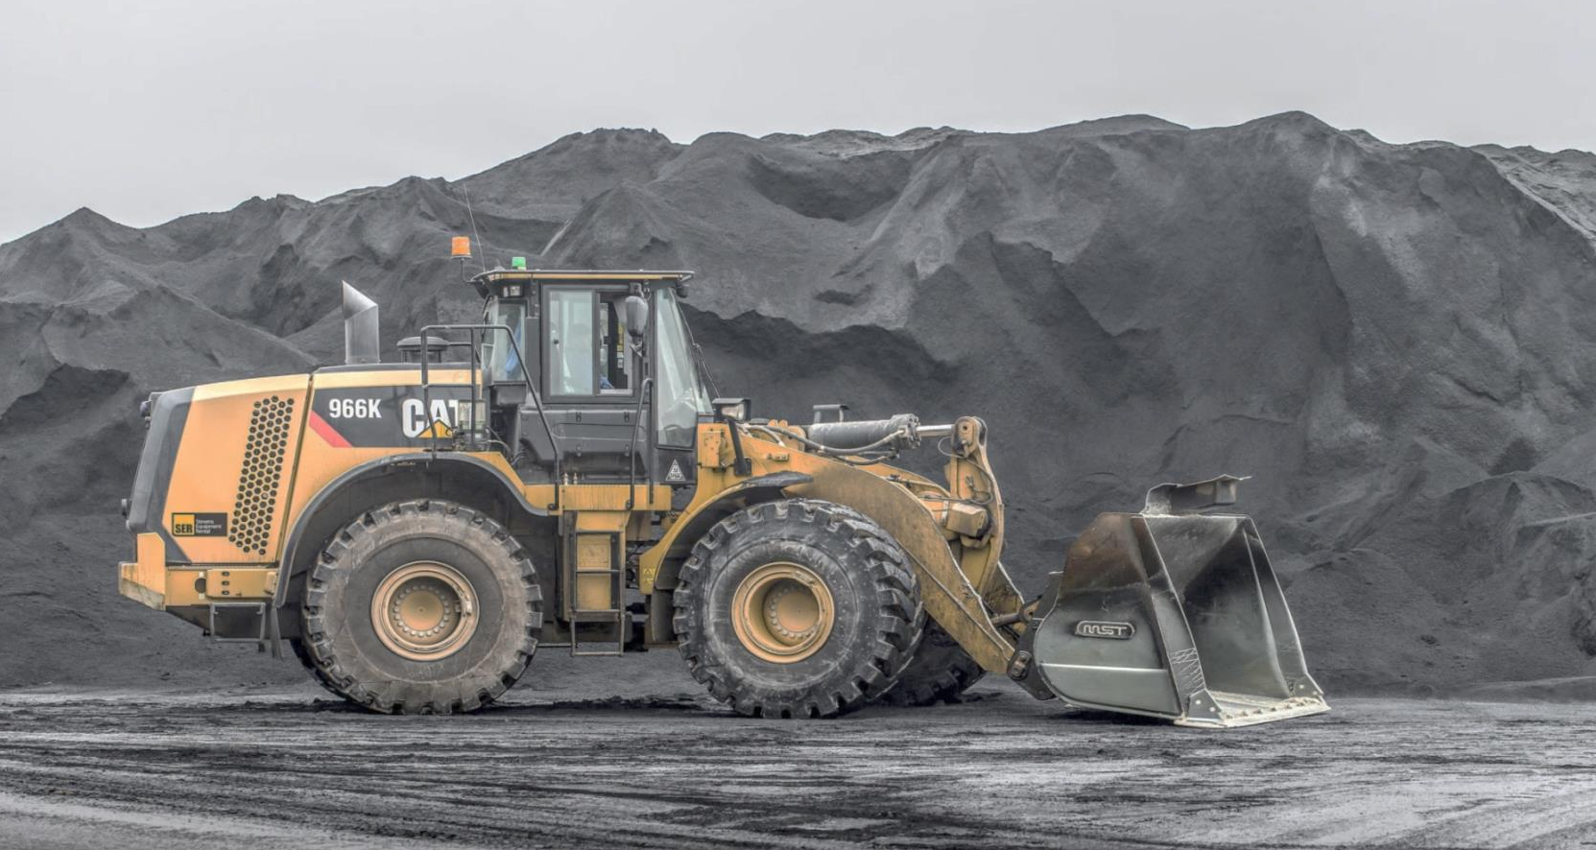


QUALITY
CERTIFICATIONS
3 years earned
100% on-time delivery
Zero recorded PPM over a
12-month period
<1% repeat platinum supplier status
PLATINUM
Over 400+ suppliers
Supplier Quality
Excellence Program
1 of only 10 to achieve gold

Slide 7
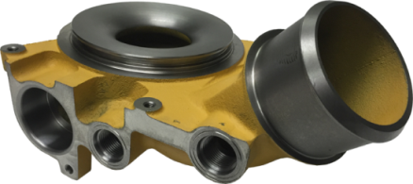
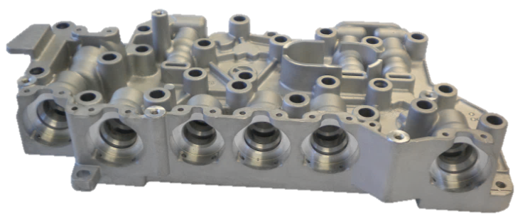
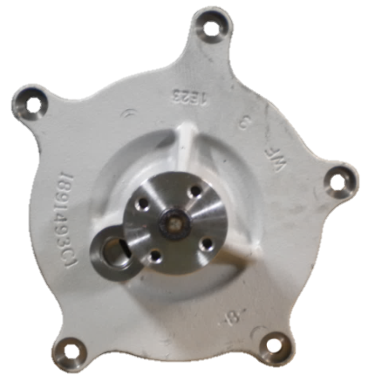
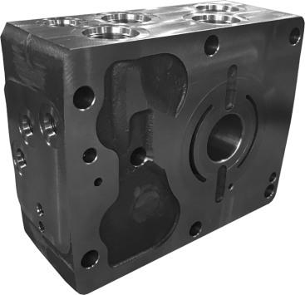
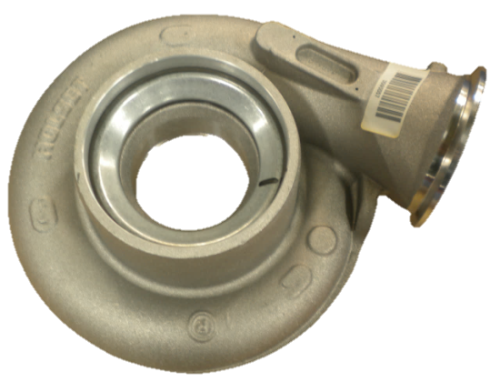
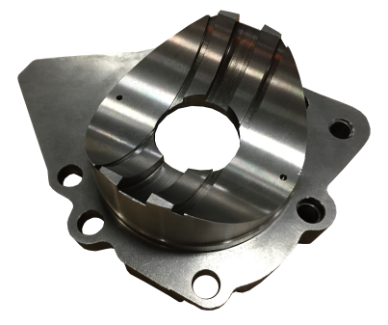
Mechanical
Oil & Water Pumps
Transmission
Components
MACHINING
& ASSEMBLY
PORTFOLIO
Assembled
Engine Components
Hydraulic Components
Turbo Components
Other Engine
Components

Slide 8
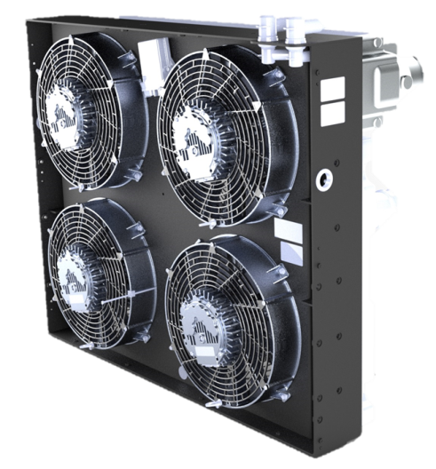
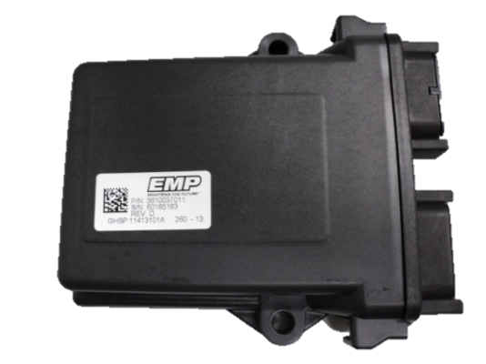
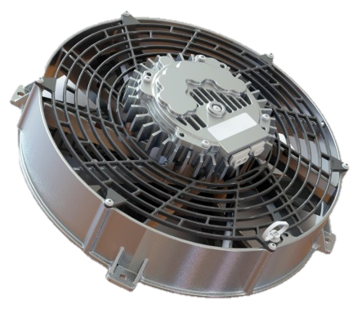
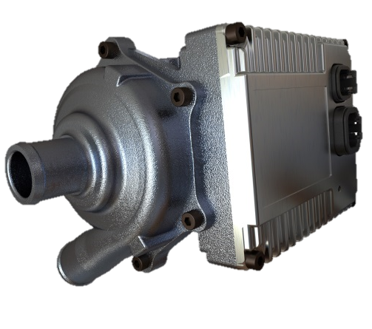
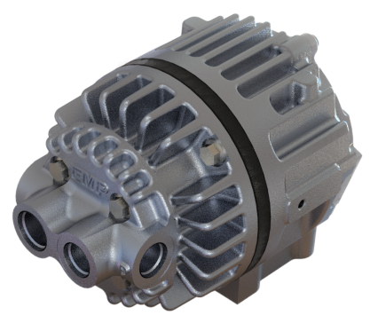
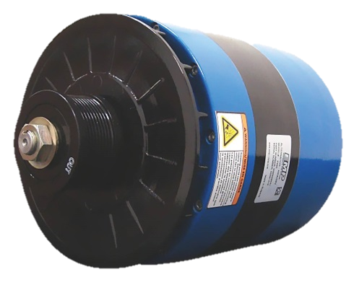
Cooling Systems
Controllers
& Software
E-PRODUCT
PORTFOLIO
Brushless DC
Electric Fans
Brushless DC
Water Pumps
Brushless DC
Oil Pumps
Alternators
Notes:
Create individual high-level slides for each component/product. Find a way to highlight or show the sell sheets.

Slide 9
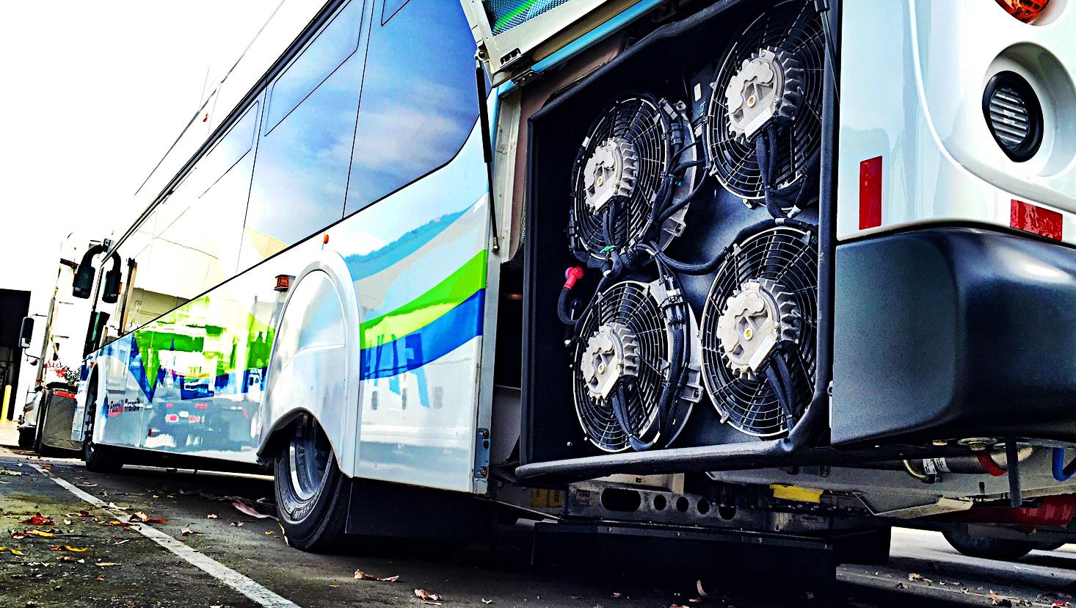
INNOVATIVE
Fully Integrated Product Development
THERMAL COOLING
SOLUTIONS
Design & Analysis
Prototyping
Performance
Testing
Vehicle Installation & Testing
Validation & Reliability Testing
In-House Engineering and Support
Solutions for Heavy-Duty Applications
Field sales and service
Engineering support capabilities
Patented hardware & software created in-house
Increased demand for better fuel economy
Lower maintenance, increased uptime
Greenhouse gas reduction

Slide 10
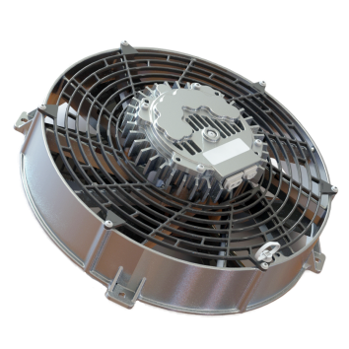
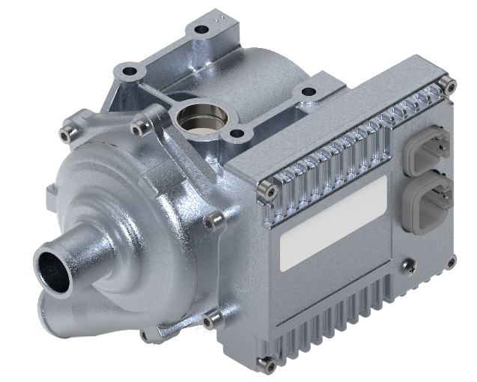
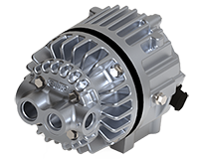
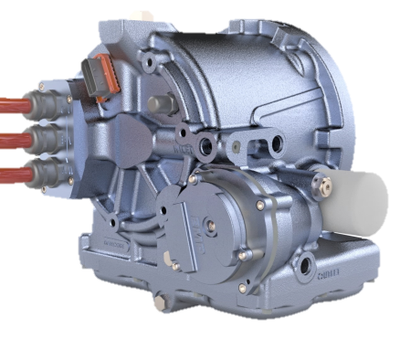
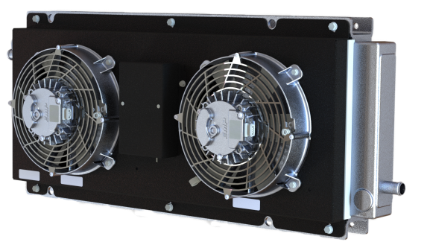
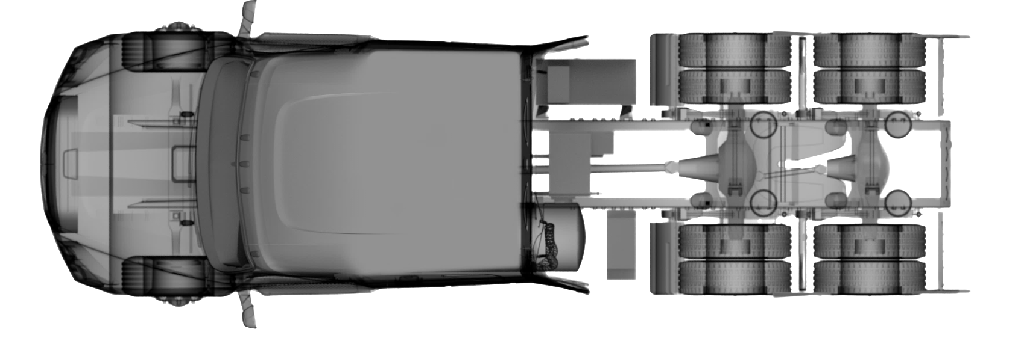
EV APPLICATIONS
MOTORS - INVERTERS - BATTERIES - GEARBOXES
Electric water pumps
Electric oil pumps
Electric fans
Integrated oil cooling
Custom cooling systems

